Slide 1

Games Research & Development Block 03 – Week 01

Slide 2

Block 03
As Block 02:Weekly sessions to oversee / discuss prototype design, iterative implementation, ongoing literature review, project management, documentation, stakeholder interaction. But with an increased focus on evaluation and reporting.
Overall focus shifting towards outcomes and reporting. The block culminates in a final presentation and review with stakeholders, completing the development work for this module.

Slide 3
THIS WEEK
PTES
Video / Demo
Reminder of the Dates + Deliverables
One-on-One Meetings

Slide 4
PTES?
Postgraduate
Taught
Experience
Survey

Slide 5
Sorry!
here

Slide 6



Last year’s slides
HAVE YOUR SAY
The Postgraduate Taught Experience Survey (PTES) is your chance to have your say about your experiences at UWE Bristol.
Results are used to improve your programme and the University
as a whole.
Complete the survey today at: https://uwe.onlinesurveys.ac.uk/ptes2018

Slide 7


WHAT IS THE PTES?
A national survey conducted of
Postgraduate Taught Students
Results are used to see where we are performing well and where you think we could improve
Your individual response is anonymous

Slide 8
HOW DO I TAKE PART?
It’s all ONLINE!
go.uwe.ac.uk/surveys
Click on the Postgraduate Taught Experience Survey (PTES)
Just login using your UWE Bristol username (e.g. a2-student)
and the password will be your student number (e.g. 01234567)
and not your usual password

Slide 9
WHAT WILL IT ASK?
It will ask about many different aspects of your student experience from teaching to assessment, engagement, skills development and projects
It gives you an opportunity to tell us in your own words what you like about your course, and what we need to improve to make your time better

Slide 10
WHAT SCALE IS USED?
The survey uses a five point scale:
Definitely Agree | Mostly Agree | Neither Agree nor Disagree | Mostly Disagree | Definitely Disagree
1 | 2 | 3 | 4 | 5
Very Satisfied | Satisfied | Neither Satisfied nor Dissatisfied | Dissatisfied | Very Dissatisfied
There is a ‘Not Applicable’ option if you think a question doesn’t apply to you or if it is too soon to say.

Slide 11

YOU SAID, WE DID
All over the university we are responding to feedback
Shape the future of your course and your university
Notes:
You may want to talk about what is quality feedback – both negative and positive comments that can help you develop your courses in the future. You can give your own examples of when you have used feedback.

Slide 12
HOW LONG WILL IT TAKE?
15 minutes
As a thank you for your time, you will have the chance to win a £100 Amazon gift voucher
We have ten vouchers to give away throughout the survey period

Slide 13
KEY POINTS
Important survey about YOUR experience
It is ANONOYMOUS
QUICK and EASY to complete ONLINE
Use your USERNAME and student ID NUMBER to login
Win a PRIZE for completing it
Make a real DIFFERENCE to the Postgraduate experience

Slide 14
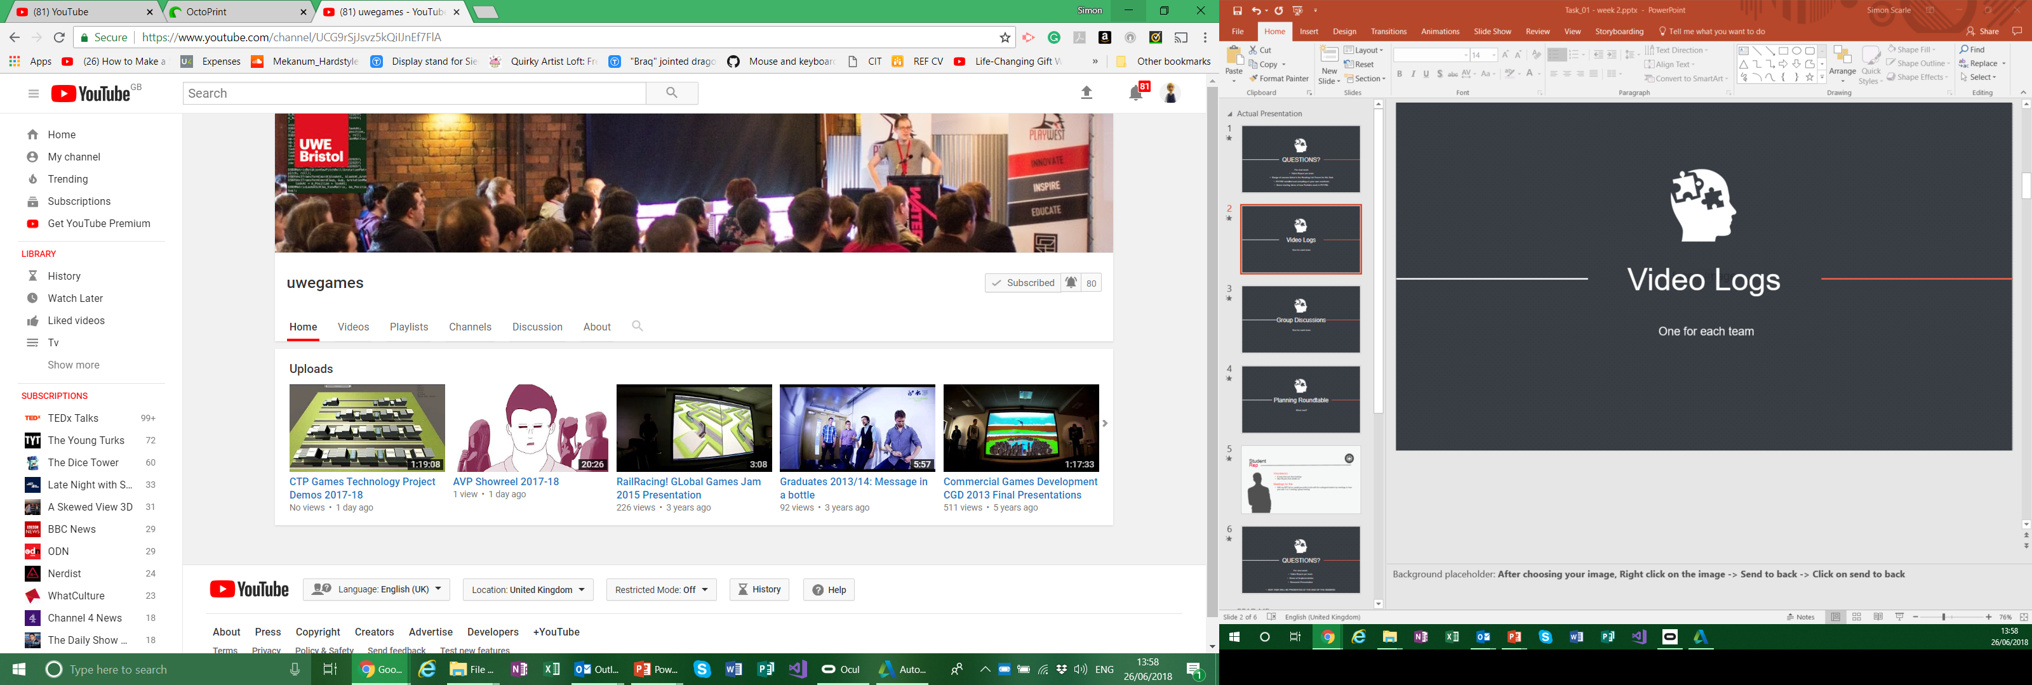
Video Logs
Place your screenshot here
Unlisted YouTube video.
I’ll add them to this years play list later!
If you think you made something pretty enough
+ TWEET + @UWEGamesMSc

Slide 15
DEMOS!
Place your screenshot here

Slide 16

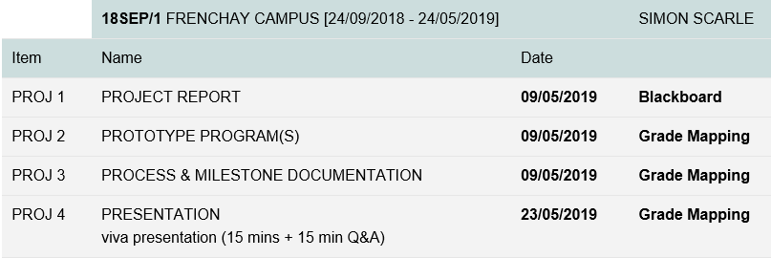
ASSESSED COMPONENTS
Assignment specification are on the Blackboard site in the assignments section
Note that at MSc level, percentage required to pass a module is 50%.

Slide 17

ASSESSED COMPONENTS
Project Report:
Should take the shape of an academic or industry research paper
Should ideally target an academic or industry journal, or alternative publication vehicle, appropriate to the project that was undertaken
Should detail the context of the problem, summarise research undertaken, and discuss and reflect on areas of technical innovation achieved within the project.
Should be written in a form suitable for wider dissemination.
Exact format and target length should be advised from publication vehicle (and agreed through discussions with tutors). The report is not expected to exceed 5000 words.
Weight: 30%

Slide 18
ASSESSED COMPONENTS
Prototype Program(s):
The software product(s) developed during the course of the project.
Should meet problem specification and stakeholder requirements.
Will be assessed in terms of design, quality, implementation, and ultimately, viability given the context.
Weight: 30%

Slide 19
ASSESSED COMPONENTS
Documentation:
Should detail the unfolding of the project in terms of approach, design and methodology.
Should provide details of stakeholder engagement and decisions made based on this interaction.
Includes links to all video logs.
Video logs should be 60 – 90 seconds in length.
While the project report and the prototype program(s) are largely about product, and dissemination of product, this component will be assessed in terms of appropriateness and professionalism with regards to the project development process.
Weight: 25%

Slide 20

ASSESSED COMPONENTS
Viva Presentation:
Should give an overview of the project by summarising the process and outcomes.
Should be in a format suitable for presentation to a panel of project stakeholders and interested others.
A Q&A session will follow immediately after, interrogating key project aspects to assess overall student learning and onward trajectory.
15 min (presentation) + 15 min (Q&A)
Weight: 15%

Slide 21
NEXT WEEK
Video / Demo
One-on-One Meetings

Slide 22
Any questions?

